Slide 1
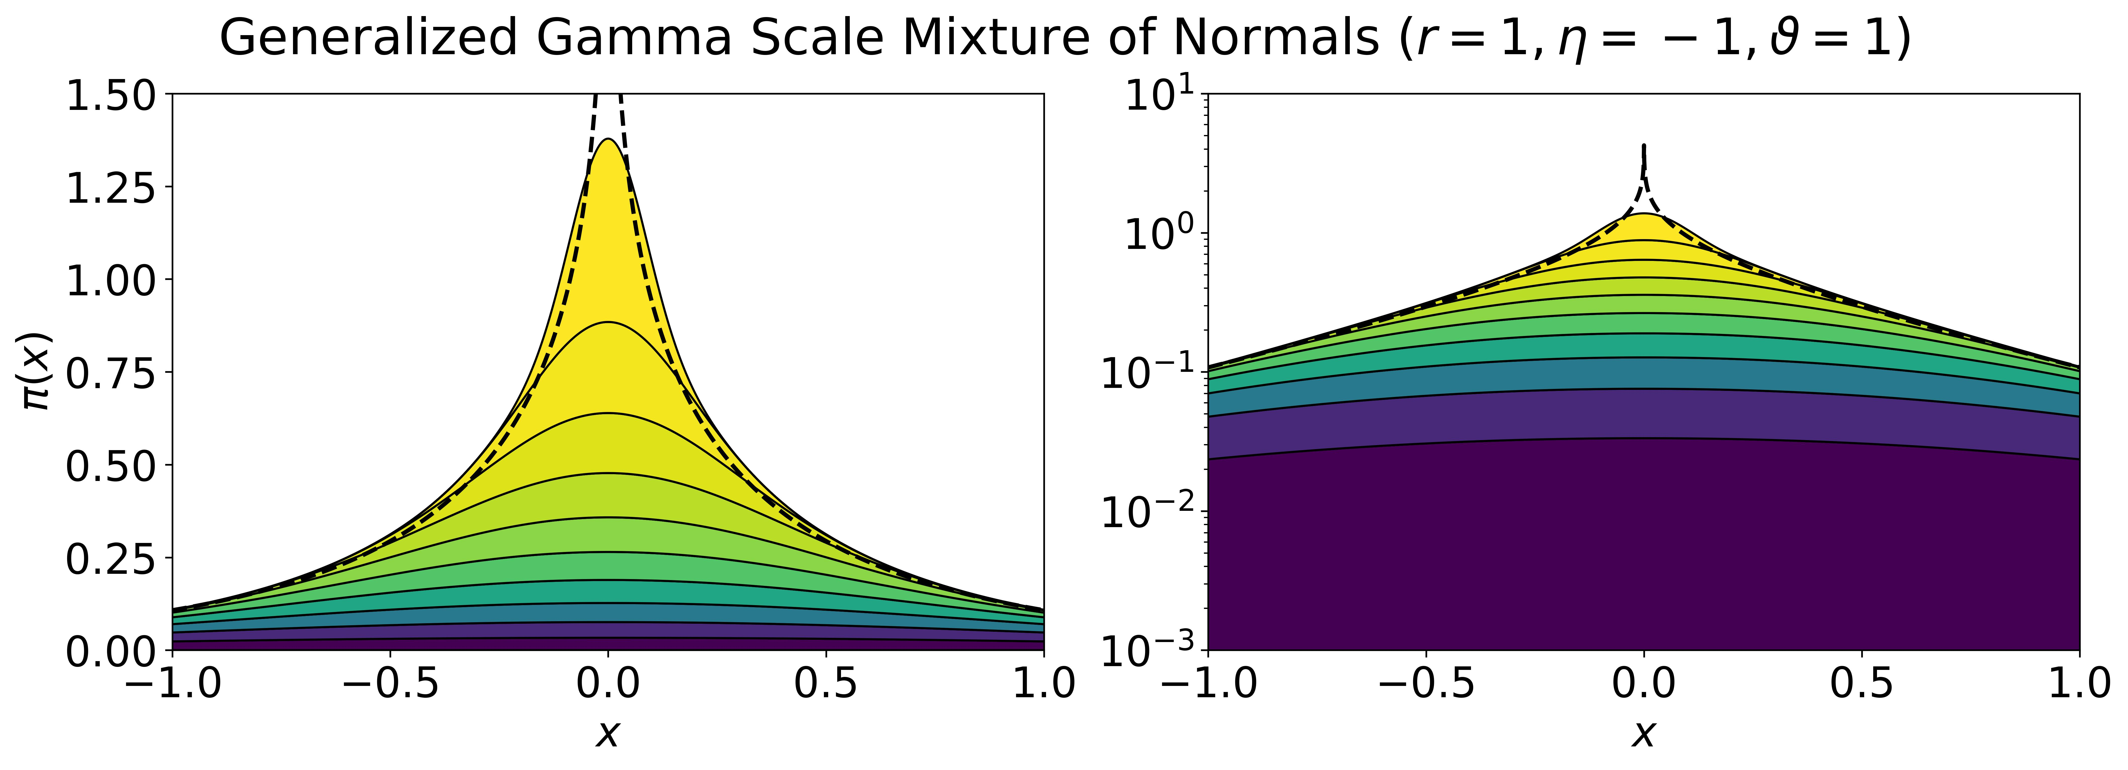
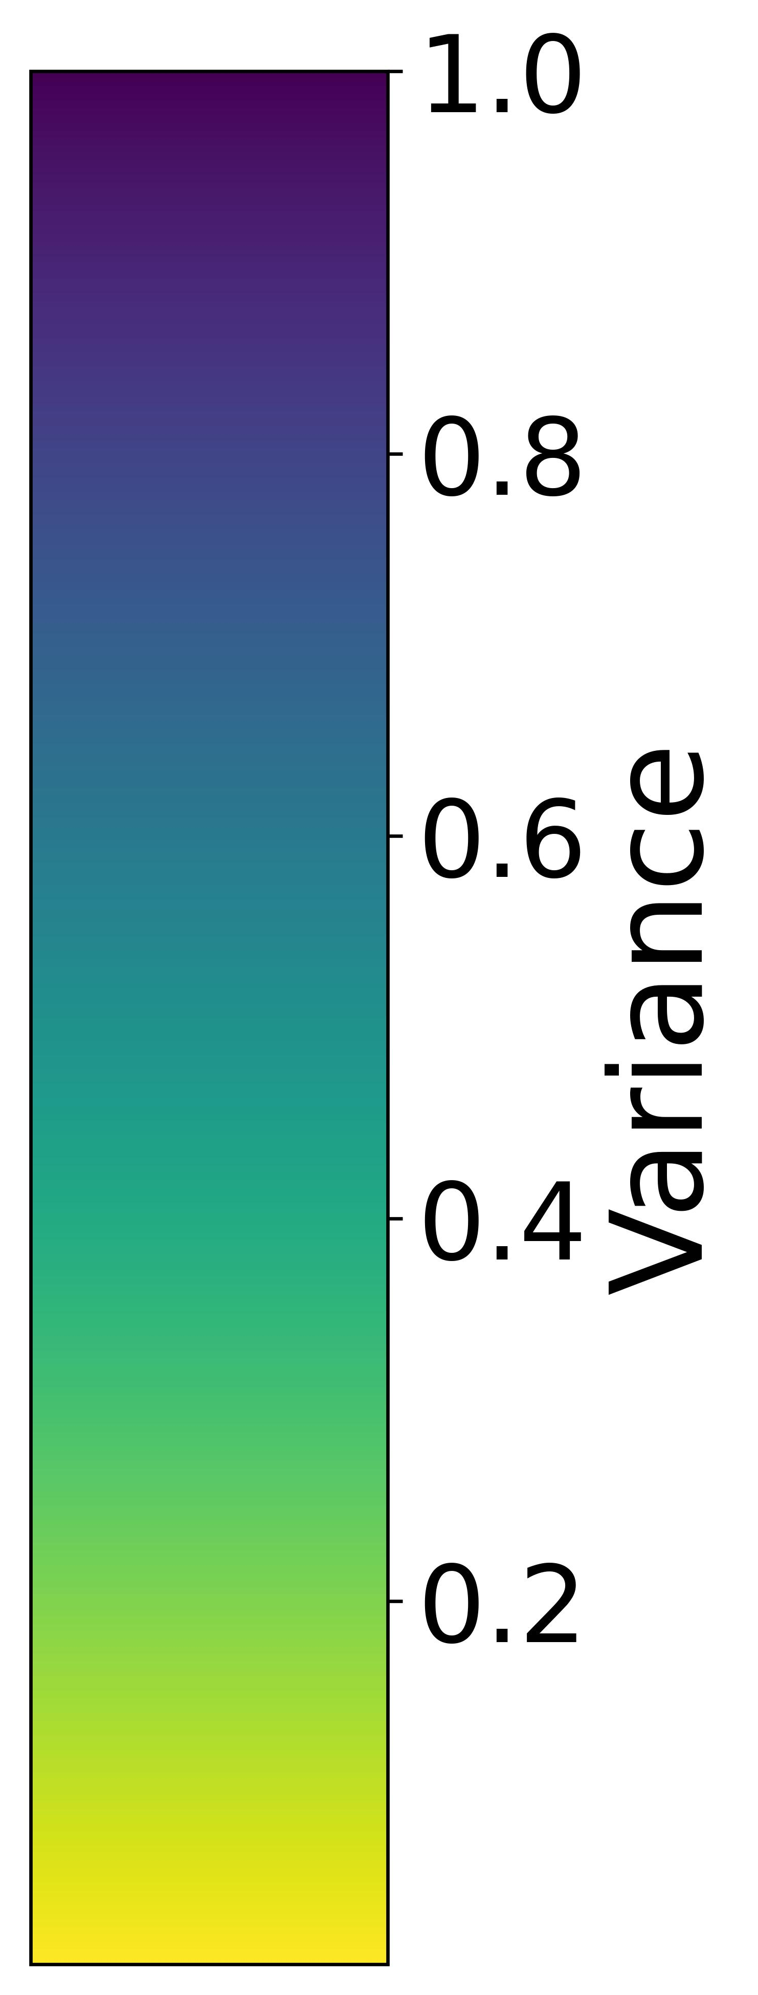

Slide 2
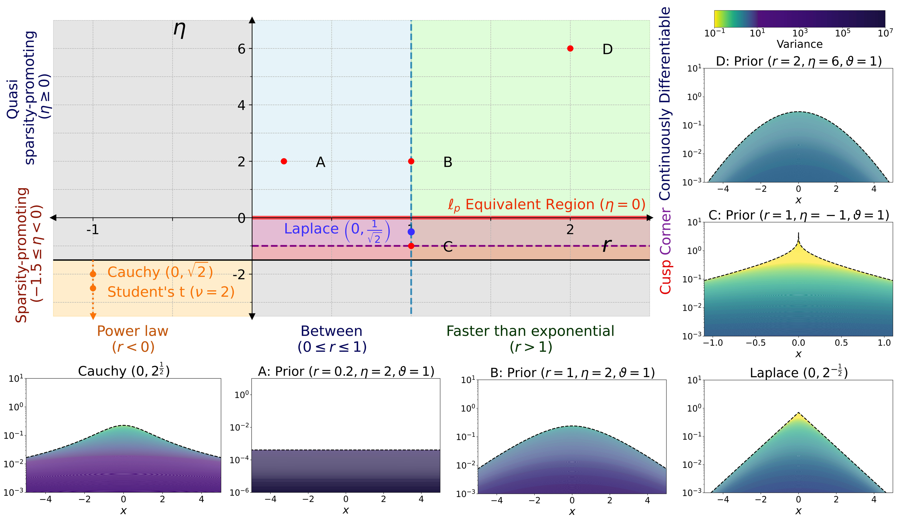
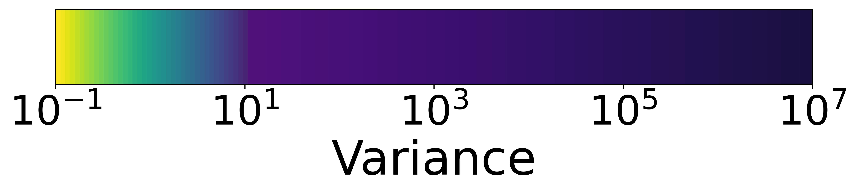
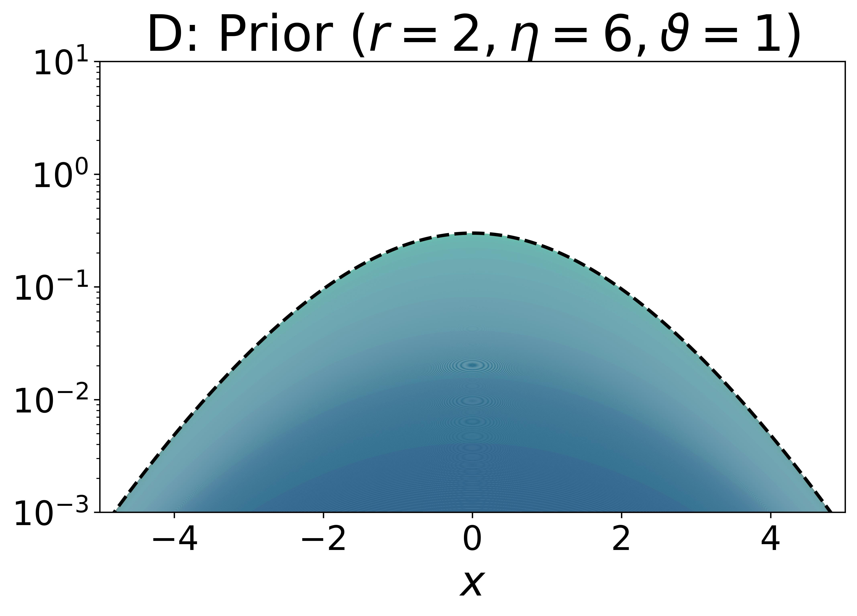
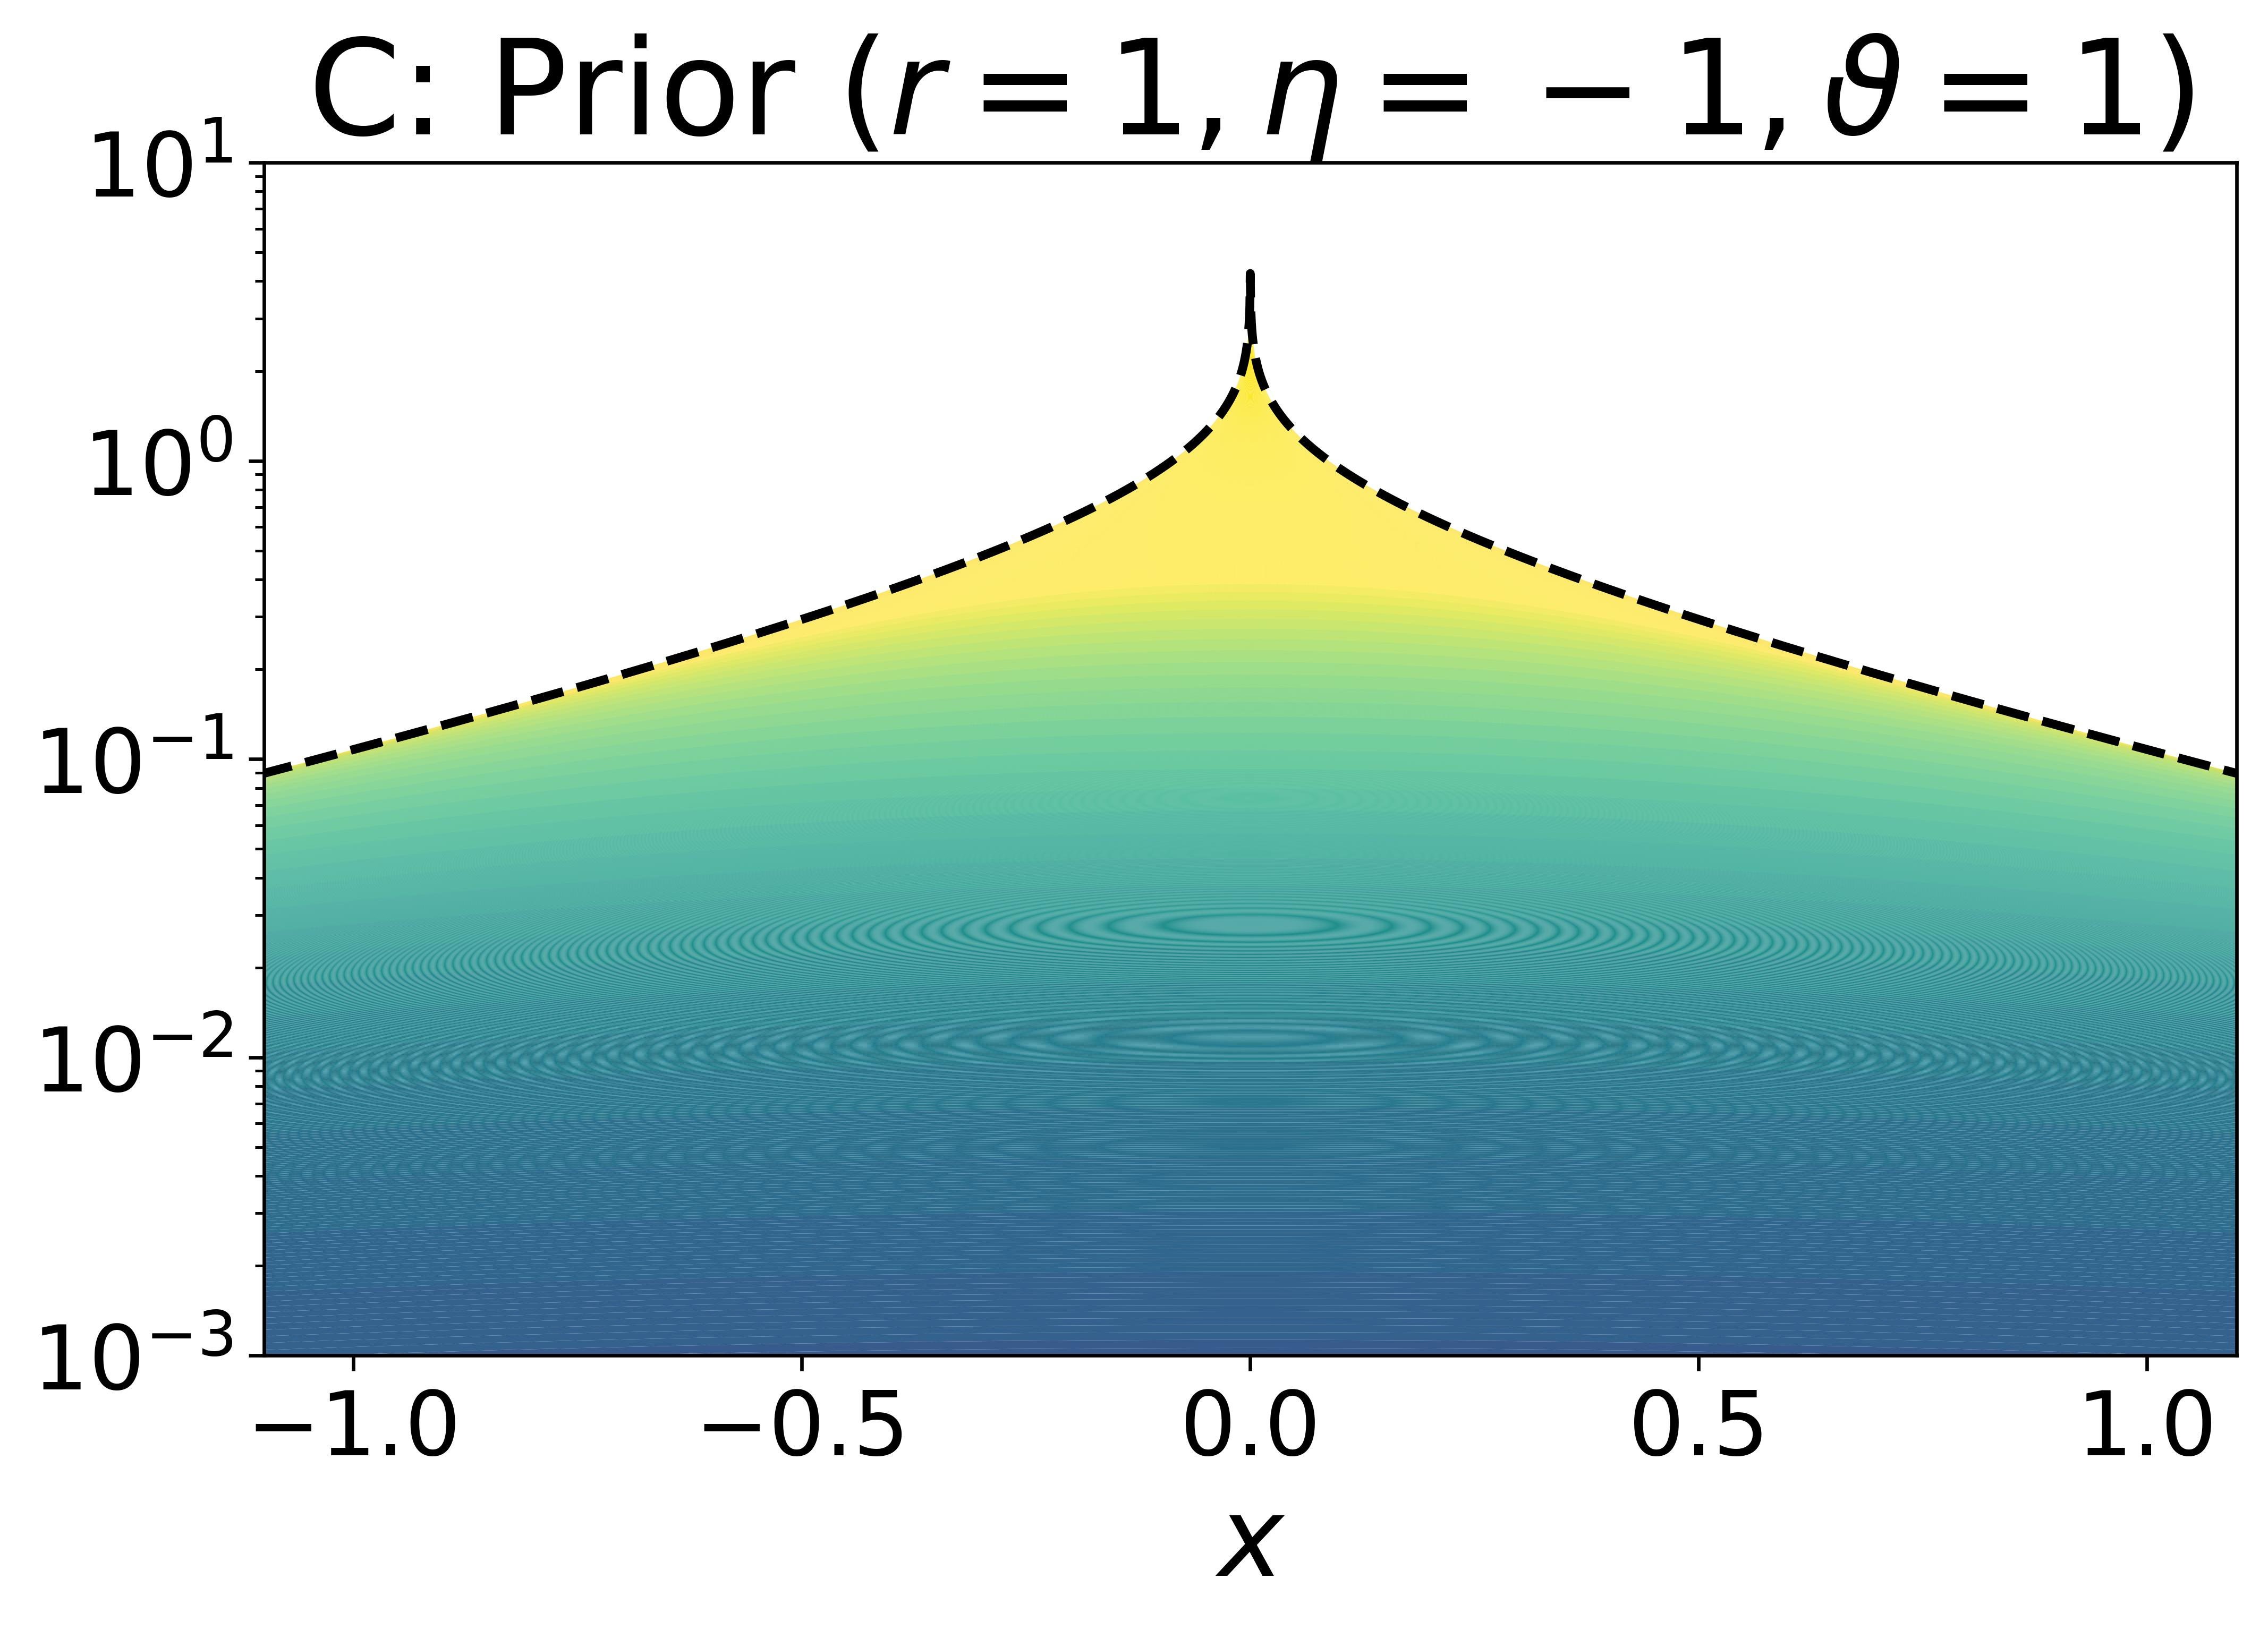
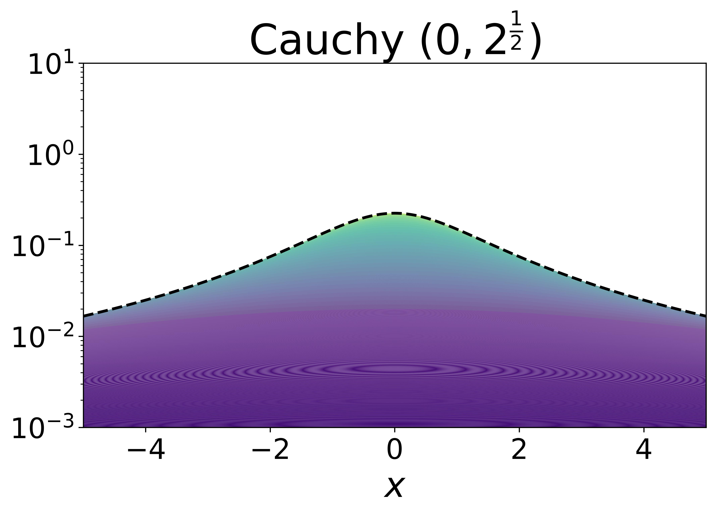
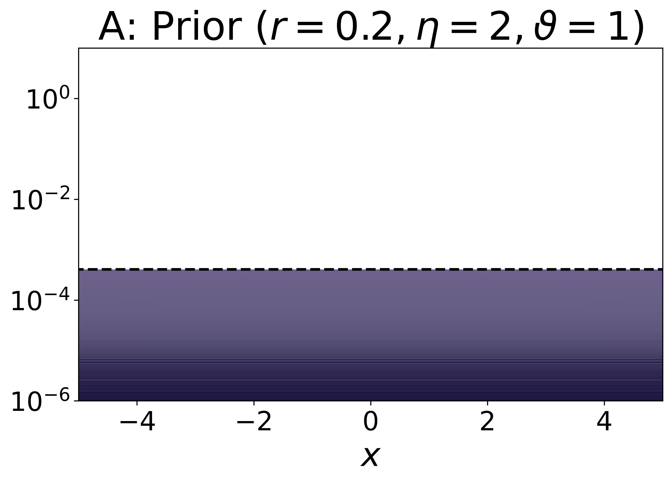
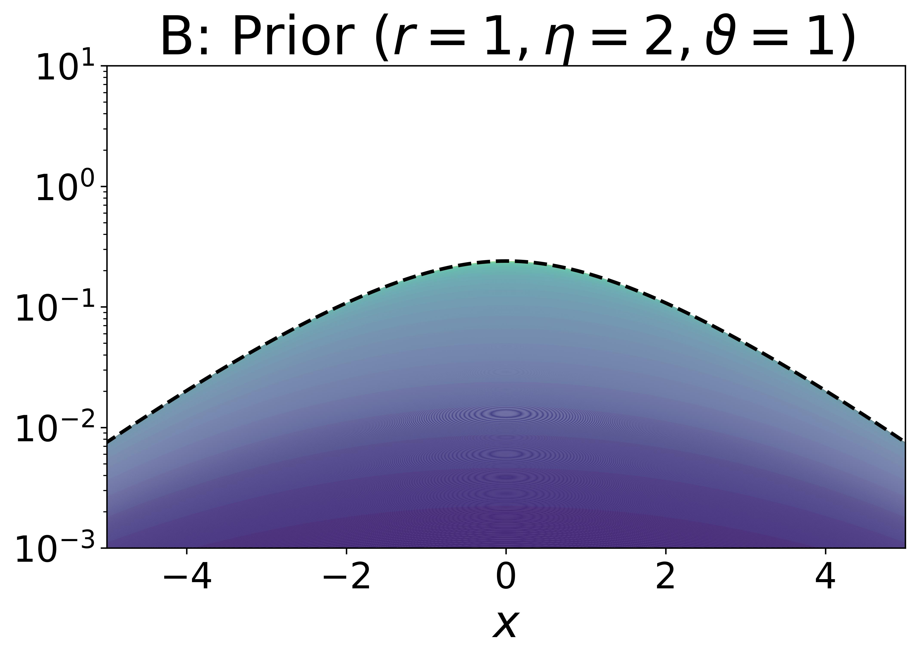
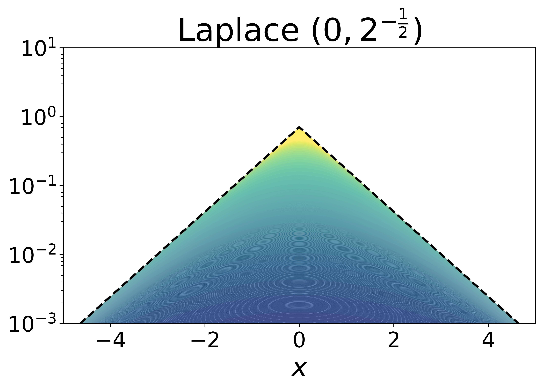

Slide 3
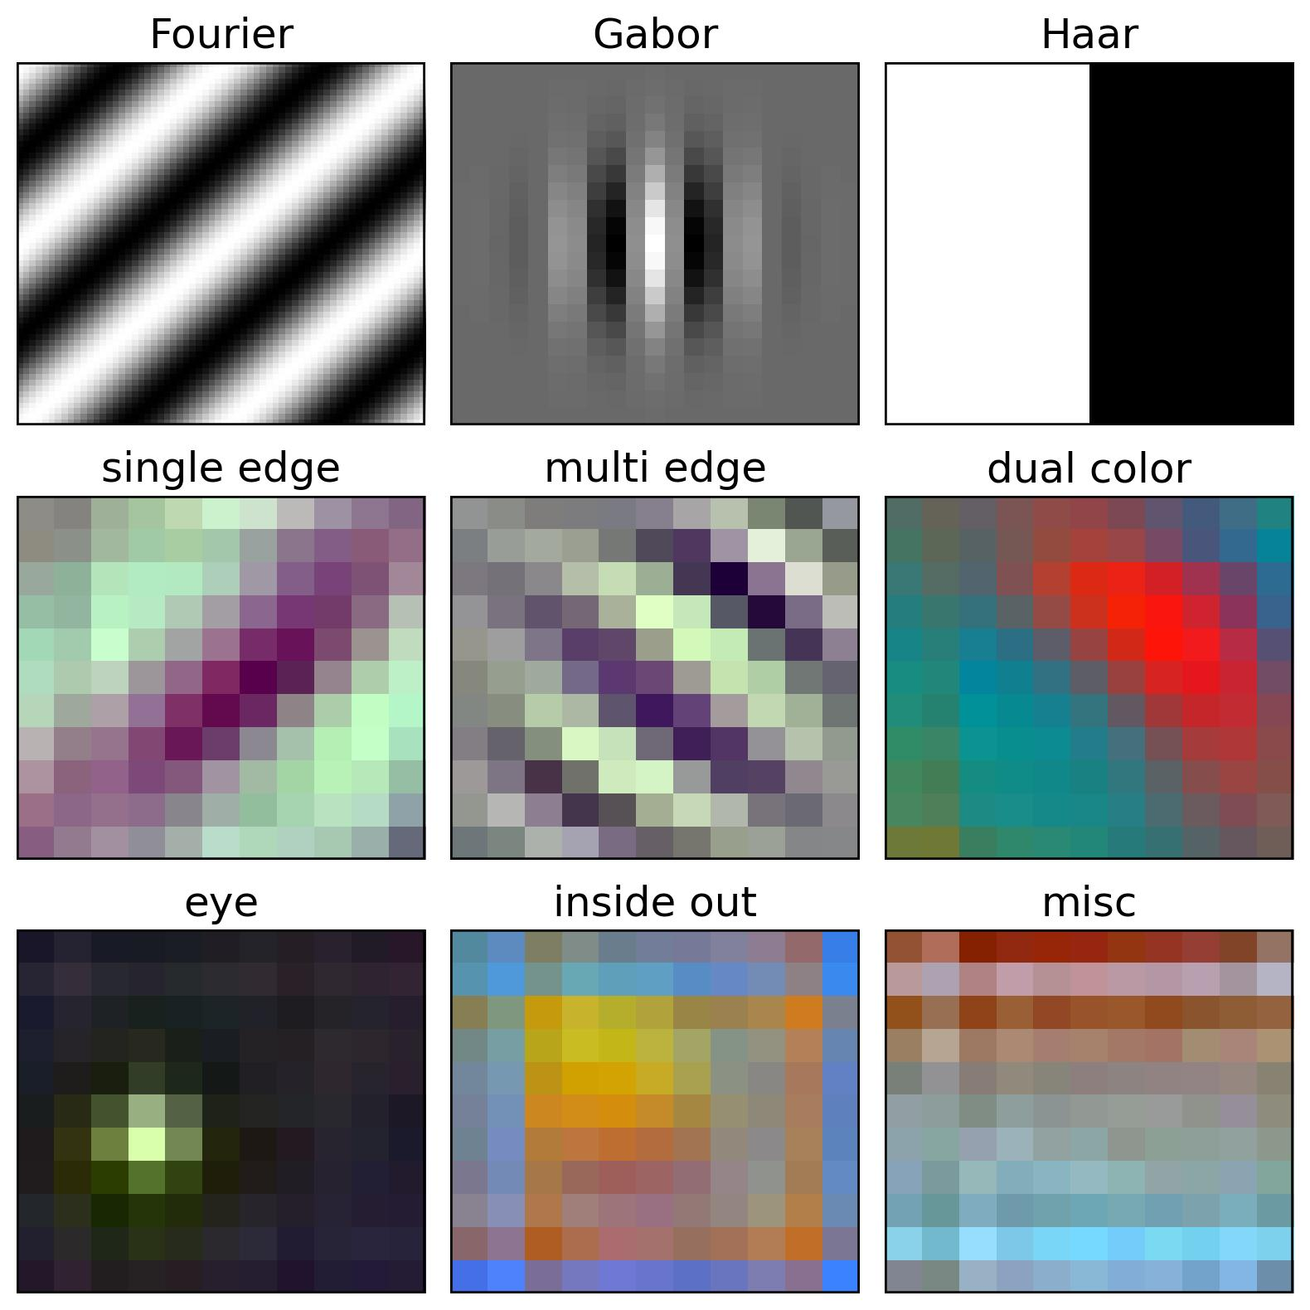
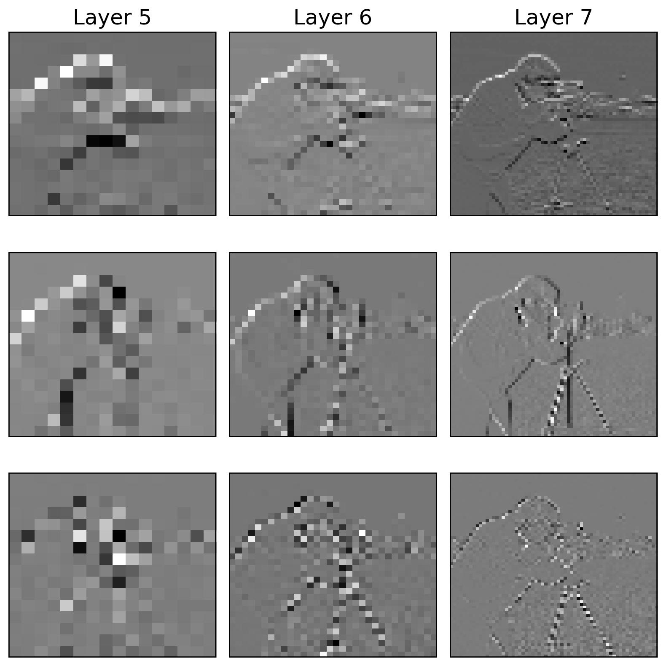
Horizontal
Vertical
Diagonal

Slide 4
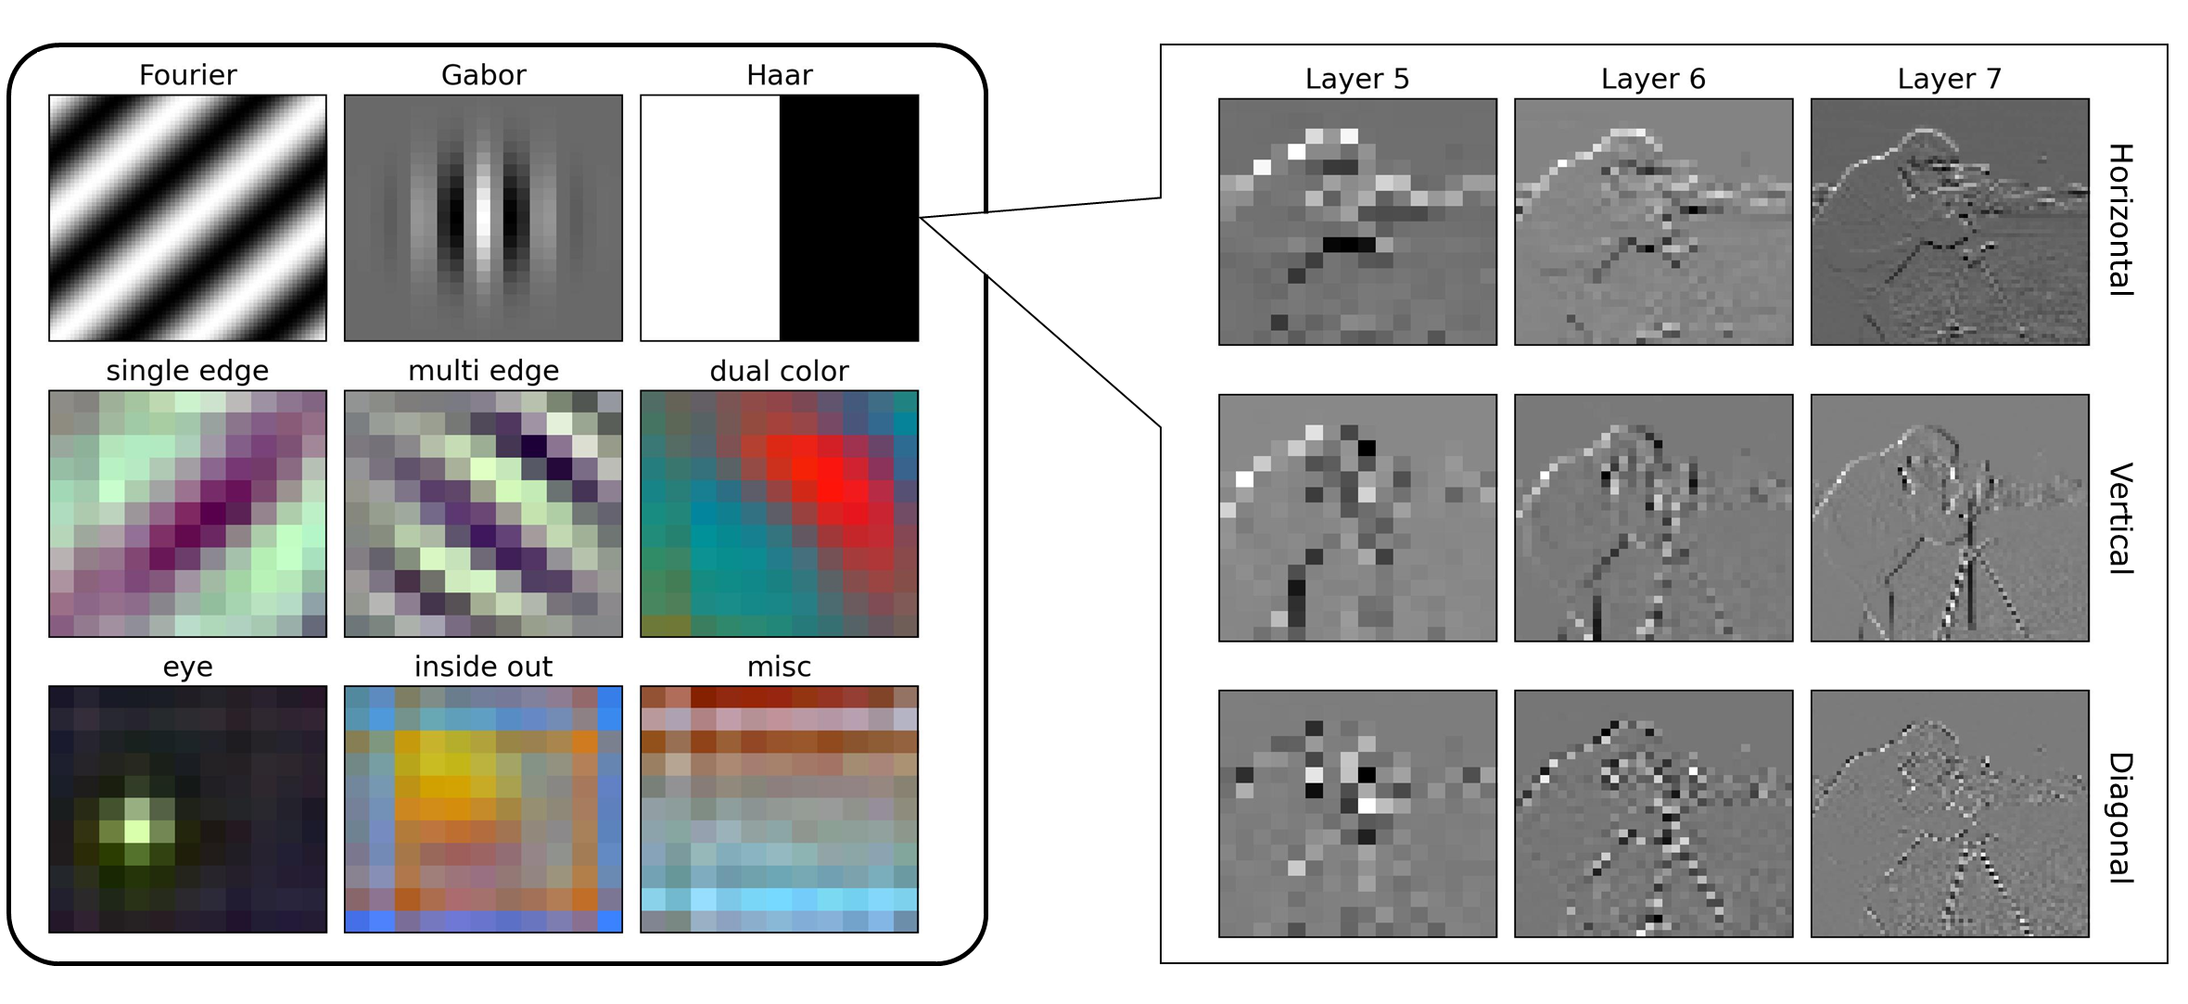
Horizontal
Vertical
Diagonal

Slide 5
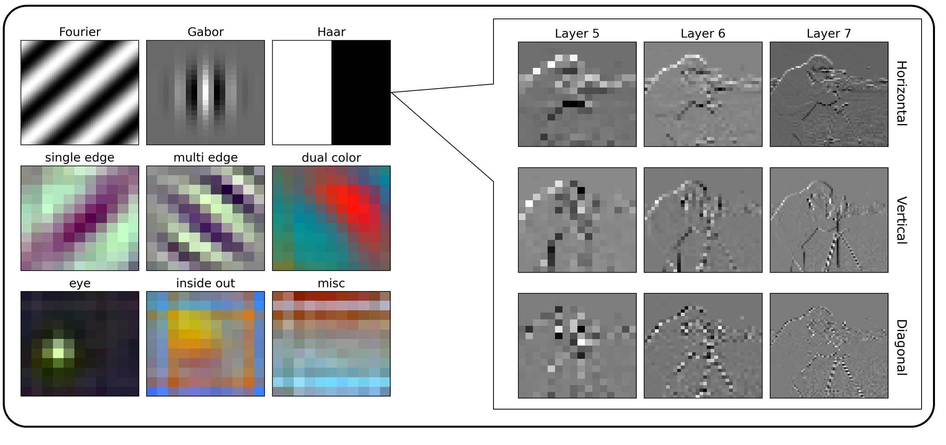
Horizontal
Vertical
Diagonal

Slide 6
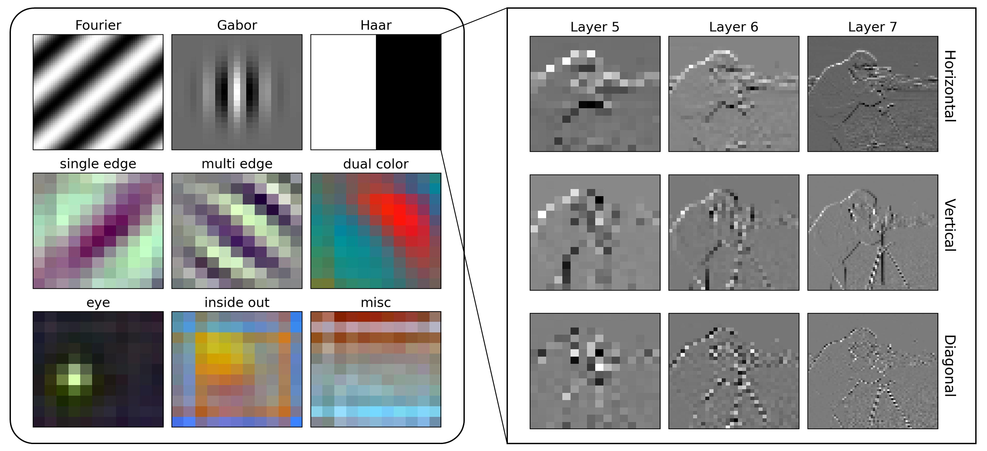
Horizontal
Vertical
Diagonal

Slide 7
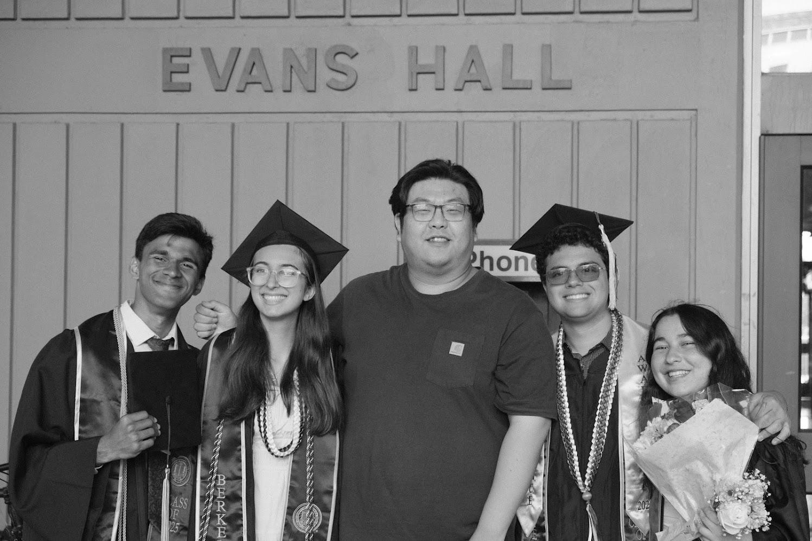
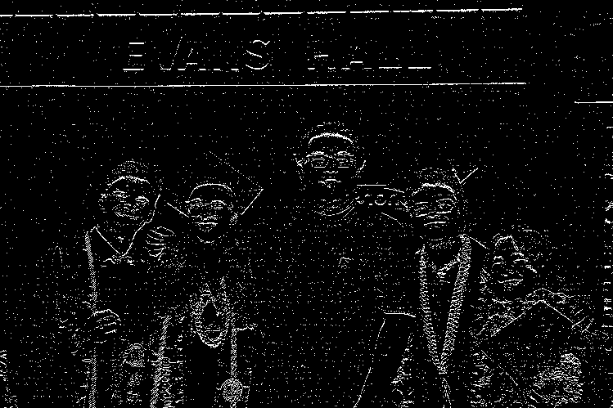
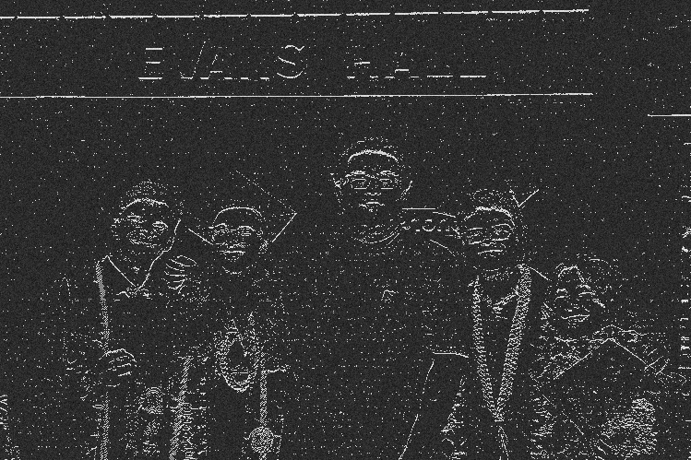
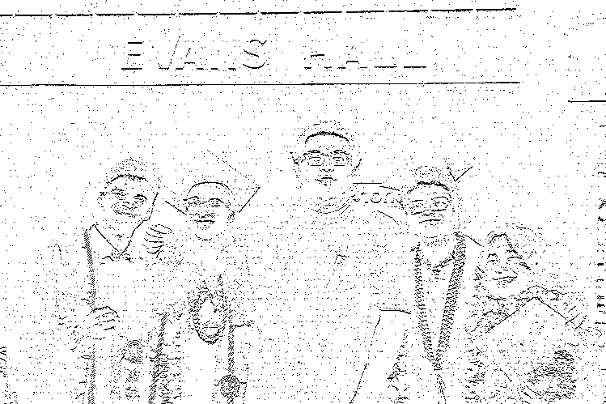
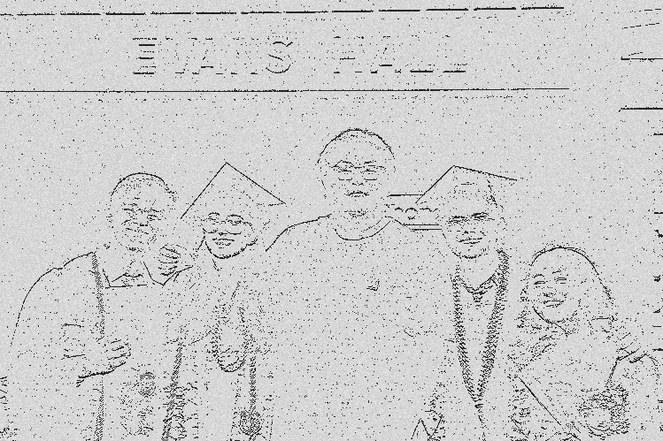
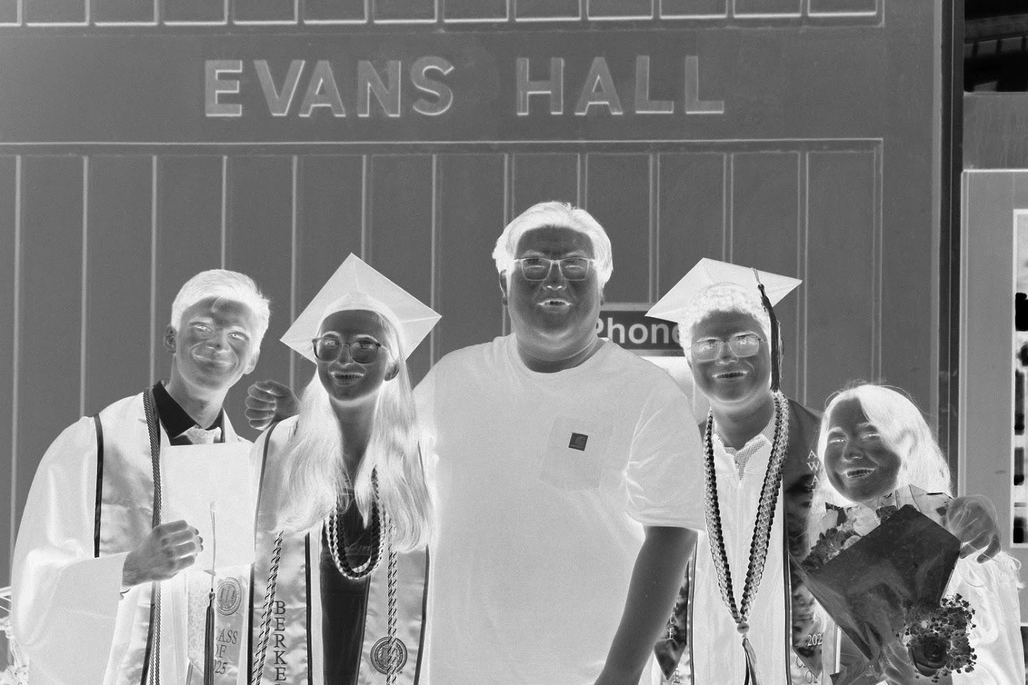


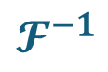
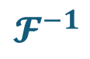






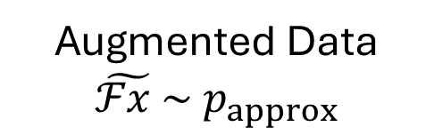

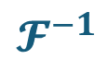


Sampled Image
$$x \sim { p}_{true}$$
Transformed Data
$$ℱx \sim { p}_{true}$$
Observable
$$Y=ℱx+ε$$
$$𝓕$$
$+$Measurement noise$ε$
Ideal Model
$$𝓕^{−1}$$
*Full Bayesian Pipeline
Transformed Data
$$ℱx \sim { p}_{true}$$
Augmented Data
$$\tilde{ℱx }\sim { p}_{approx}$$
$$\tilde{Y}=\tilde{ℱx}+ε$$
*Inverse Data Augmentation
Data Augmentation
Make Observation
Augmentation post hoc
$$𝓕$$
$$𝓕^{−1}$$
*Inverse Data Augmentation
Full Bayesian Pipeline
Augmented Image
$$\tilde{x} \sim \tilde{p}$$
Transformed Data
$$\tilde{ℱx} \sim { p}_{approx}$$
$$\tilde{Y}=\tilde{ℱx}+ε$$
Image Augmentation
Make Observation
$$𝓕$$
Augmentation ante hoc
Inverse Image Augmentation
$$𝓕^{−1}$$
Full Bayesian Pipeline
Notes:
Brandon Version

Slide 8






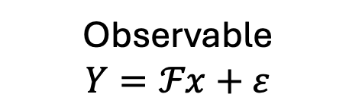

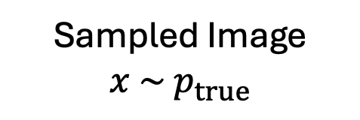
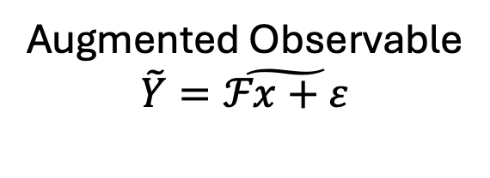

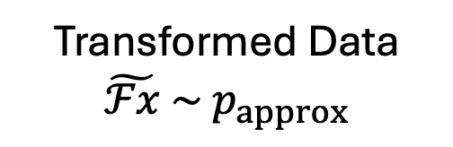

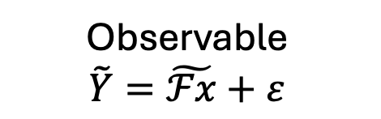
Sampled Image
$$x \sim { p}_{true}$$
Transformed Data
$$ℱx \sim { p}_{true}$$
Observable
$$Y=ℱx+ε$$
$$𝓕$$
$+$Measurement noise$ε$
Ideal Model
$$𝓕^{−1}$$
*Full Bayesian Pipeline
Transformed Data
$$ℱx \sim { p}_{true}$$
Observable
$$Y=ℱx+ε$$
Augmented Observable
$$\tilde{Y}=\tilde{ℱx+ε}$$
*Inverse Data Augmentation
Make Observation
Data Augmentation
Augmentation post hoc
$$𝓕$$
$$𝓕^{−1}$$
Full Bayesian Pipeline
*Inverse Data Augmentation
Augmented Image
$$\tilde{x} \sim \tilde{p}$$
Transformed Data
$$\tilde{ℱx} \sim { p}_{approx}$$
Observable
$$\tilde{Y}=\tilde{ℱx}+ε$$
Image Augmentation
Make Observation
$$𝓕$$
Augmentation ante hoc
Inverse Image Augmentation
$$𝓕^{−1}$$
Full Bayesian Pipeline
Notes:
Strang Version

Slide 9





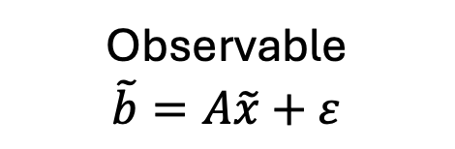
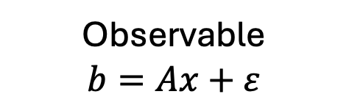

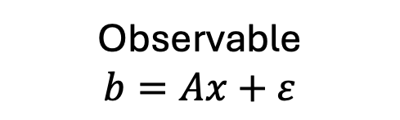

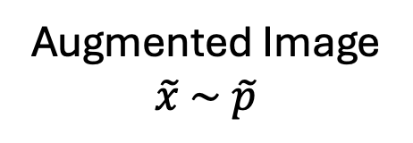
Sampled Image
$$x \sim { p}_{true}$$
Transformed Image
$$Ax$$
Observable
$$b=Ax+ε$$
$$A$$
Make Observation
Ideal Model
Post = Lik(b) * P_true
Transformed Image
$$Ax$$
Observable
$$b=Ax+ε$$
Augmented Observable
$$\tilde{b}=\tilde{Ax+ε}$$
Data Augmentation
Make Observation
Augmentation post hoc
$$A$$
*Inverse Data Augmentation
Full Bayesian Pipeline
Augmented Image
$$\tilde{x} \sim \tilde{p}$$
Transformed Image
$$A\tilde{x}$$
Observable
$$\tilde{b}=A\tilde{x}+ε$$
Image Augmentation
Make Observation
$$A$$
Augmentation ante hoc
Inverse Image Augmentation
Post = Lik(b_tilda) * P_tilda
Notes:
Strang Version New letters

Slide 10






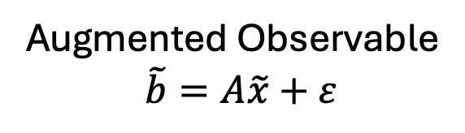

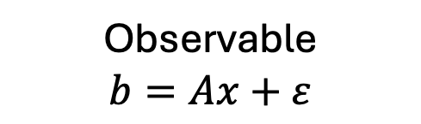









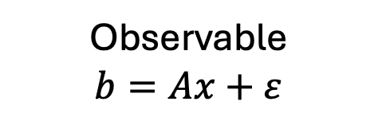

Sampled Image
$$x \sim { p}_{true}$$
Transformed Image
$$Ax$$
Observable
$$b=Ax+ε$$
$$A$$
Make Observation
Ideal Model
$$Post∝Lik\left(b\right) p_{true}$$
Augmented Image
$$x \sim \tilde{p}$$
Transformed Image
$$A\tilde{x}$$
$$A$$
Image Augmentation
Make
Observation
Sampled Image
$$x \sim { p}_{true}$$
Augmented Observable
$$\tilde{b}=A\tilde{x}+ε$$
Inverse Image Augmentation
$$Post∝Lik\left(\tilde{b}\right) \tilde{p}$$
$$Post∝\tilde{Lik}\left(\tilde{b}\right) p_{true}$$
Augmented Model
$$Post∝Lik\left(b\right) p_{true}$$
Transformed Image
$$Ax$$
Observable
$$b=Ax+ε$$
Data Augmentation
$$A$$
$$\tilde{b}=\tilde{Ax+ε }$$
Make
Observation
Notes:
Strang Version Post Meeting

Slide 11


Sampled Image
$$x \sim { p}_{true}$$
Transformed Image
$$Ax$$
Observable
$$b=Ax+ε$$
$$A$$
Make Observation
Ideal Model
$$Post∝Lik\left(b\right) p_{true}$$
Augmented Image
$$x \sim \tilde{p}$$
Transformed Image
$$A\tilde{x}$$
$$A$$
Image Augmentation
Make
Observation
Sampled Image
$$x \sim { p}_{true}$$
Augmented Observable
$$\tilde{b}=A\tilde{x}+ε$$
Inverse Image Augmentation
$$Post∝Lik\left(\tilde{b}\right) \tilde{p}$$
Augmented Model
$$Post∝\tilde{Lik}\left(\tilde{b}\right) p_{true}$$
Transformed Image
$$Ax$$
Observable
$$b=Ax+ε$$
Data Augmentation
$$A$$
$$\tilde{b}=\tilde{Ax+ε }$$
Make
Observation
Notes:
Strang Version Post Meeting No bottom arrow

Slide 12


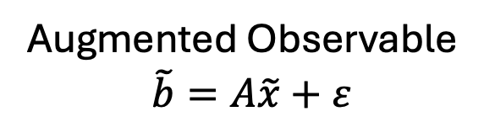



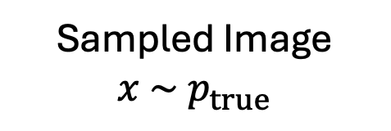

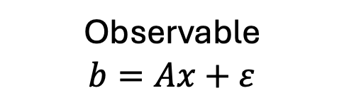


`
Augmented Image
$$x \sim \tilde{p}$$
Transformed Image
$$A\tilde{x}$$
$$A$$
Image Augmentation
Make
Observation
Sampled Image
$$x \sim { p}_{true}$$
Augmented Observable
$$\tilde{b}=A\tilde{x}+ε$$
Inverse Image Augmentation
$$Post∝Lik\left(\tilde{b}\right) \tilde{p}$$
$$Post∝\tilde{Lik}\left(\tilde{b}\right) p_{true}$$
$$Post∝Lik\left(b\right) p_{true}$$
Data Augmentation
$$\tilde{b}=\tilde{Ax+ε }$$
$$A$$
Transformed Image
$$Ax$$
Observable
$$b=Ax+ε$$
Make
Observation
Notes:
Strang Version Post Meeting

Slide 13
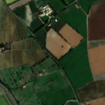
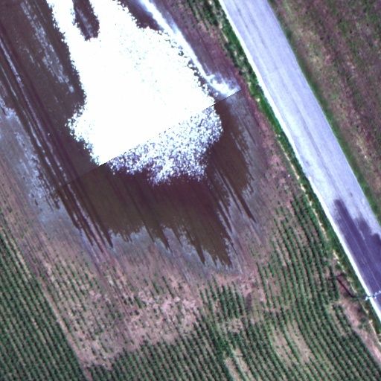
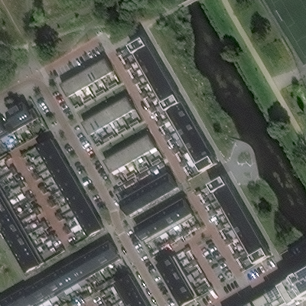

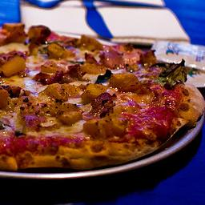


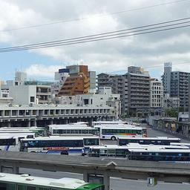
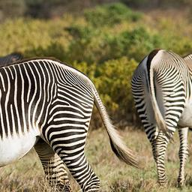
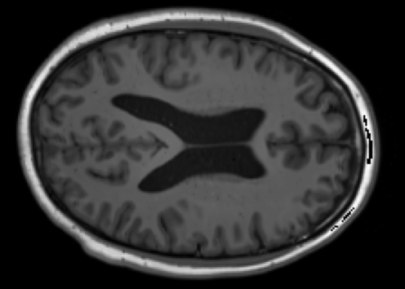
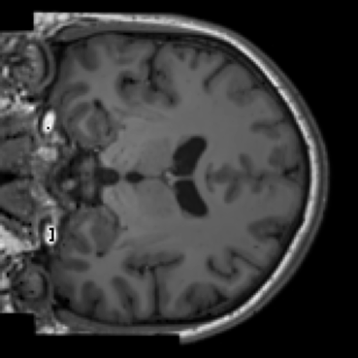
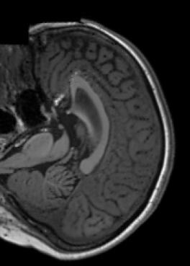

Slide 14






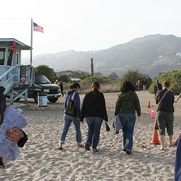




Slide 15


Slide 16

Remote Sensing
Natural
Medical
Classical

Slide 17

Remote Sensing
Natural
Medical
Classical

Slide 18






